Slide 1
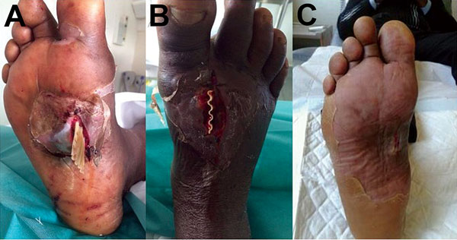
Figure
Figure. A) Foot of a 47-year-old man showing wound infected with Sporolactobacillus laevolaticus, Marseille, France. B) Drainage of a cellulitis abscess. C) Extent to which the wound on the arch of the foot had healed 6 weeks after surgery and antimicrobial drug therapy. A color version of this figure is available online (http://wwwnc.cdc.gov/EID/article/21/11/15-1197-F1.htm).
Abat C, Kerbaj J, Dubourg G, Garcia V, Rolain J. Human Infection with Sporolactobacillus laevolacticus, Marseille, France. Emerg Infect Dis. 2015;21(11):2106-2108. https://doi.org/10.3201/eid2111.151197

