Slide 1
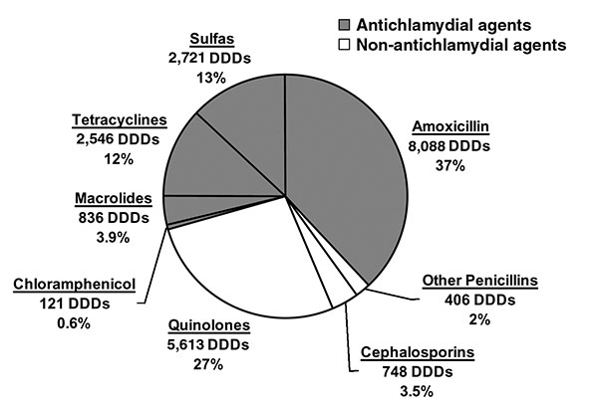
Figure 1
Figure 1.&nbsp;Antimicrobial drug use in Geta, Nepal. Antimicrobial drug sales in a 3-month period (mid-February to mid-May 2000) from all pharmacies in the Geta subdistrict, expressed as defined daily doses (DDDs) and as a percentage of the total DDDs sold (6). The shaded region represents antimicrobial drugs that are effective against Chylmydia trachomatis.
Chidambaram JD, Bird M, Schiedler V, Fry AM, Porco T, Bhatta RC, et al. Trachoma Decline and Widespread Use of Antimicrobial Drugs. Emerg Infect Dis. 2004;10(11):1896-1899. https://doi.org/10.3201/eid1011.040476

