Slide 1
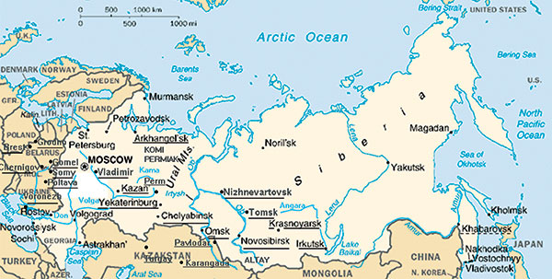
Figure 2
Figure 2.&nbsp;Opisthorchis (solid lines) and Clonorchis (broken lines) endemic areas in the former USSR. Original map was obtained from the United Nations Development Programme Web site (www.undp.org).
Yossepowitch O, Gotesman T, Assous M, Marva E, Zimlichman R, Dan M. Opisthorchiasis from Imported Raw Fish. Emerg Infect Dis. 2004;10(12):2122-2126. https://doi.org/10.3201/eid1012.040410

