Slide 1
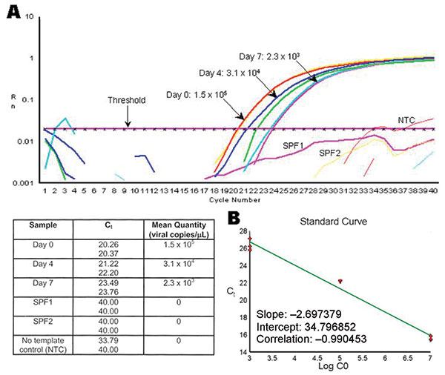
Figure 2
Figure 2.&nbsp;Example of the decrease on Taura syndrome virus (TSV) genome copy number within tissue cell culture flasks exposed to TSV. A) Real time reverse transcription–polymerase chain reaction plots and mean quantity of TSV copies/μL from tissue cell culture media collected at days 0, 4, and 7 postinfection from MA-104 cell flasks injected with TSV-infected shrimp hemolymph. Samples of tissue cell culture media collected from FrhK-4 and BGMK cell culture flasks inoculated with TSV-infected hemolymph or hepatopancreas also decreased by &gt;1 log in concentration of viral copies as a function of time.. The value of 33.79 obtained for one of the NTC replicates is considered an artifact. B) Standard curve of TSV copy number versus threshold cycle (Ct) value. Purified TSV plasmid was serially diluted and used as templates in real time polymerase chain reaction. The resulting Ct values are plotted against the logarithm of their respective copy numbers. Rn, fluorescence signal; SPF 1 and 2, specific pathogen free; NTC, no template control.
Pantoja CR, Navarro SA, Naranjo J, Lightner DV, Gerba CP. Nonsusceptibility of Primate Cells to Taura Syndrome Virus. Emerg Infect Dis. 2004;10(12):2106-2112. https://doi.org/10.3201/eid1012.040419

