Slide 1
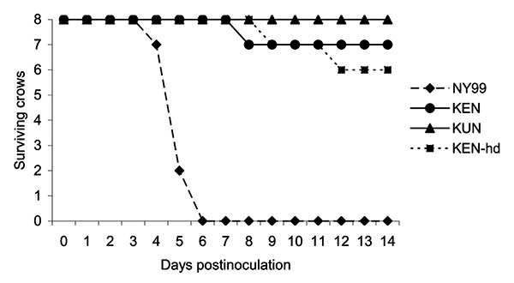
Figure 2
Figure 2.&nbsp;Survivorship of eight American Crows, each injected with 3.2 log10 PFU of NY99, KEN, or KUN virus. An additional eight crows were injected with a high dose (hd) of the KEN virus (3.8 log10 PFU). Crows were monitored daily for signs of disease through 14 dpi. No deaths were found within the control group (data not shown).
Brault AC, Langevin SA, Bowen RA, Panella NA, Biggerstaff BJ, Miller BR, et al. Differential Virulence of West Nile Strains for American Crows. Emerg Infect Dis. 2004;10(12):2161-2168. https://doi.org/10.3201/eid1012.040486

