Slide 1
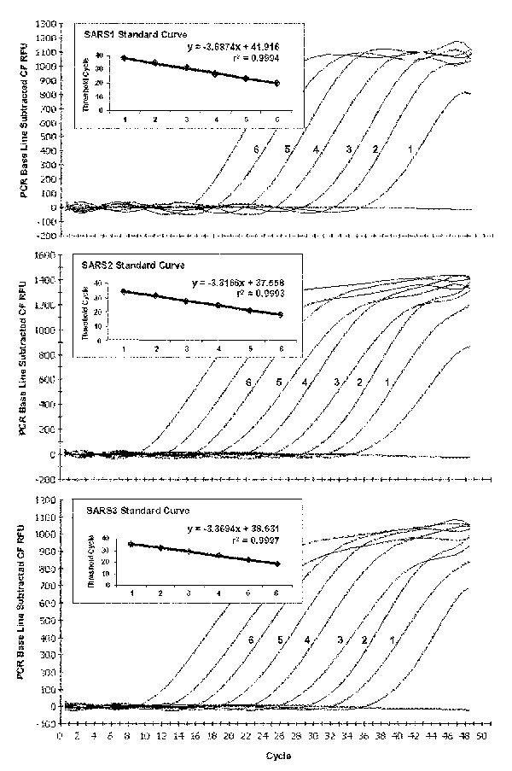
Figure
Figure.&nbsp;Typical amplification plot derived from serial 10-fold dilutions of severe acute respiratory syndrome–associated coronavirus RNA transcripts using TaqMan reverse transcription–polymerase chain reaction primer/probe sets SARS1, SARS2, and SARS3. A PCR Base Line Subtractive Curve Fit view of the data is shown with relative fluorescence units (RFU) plotted against cycle number. The default setting of 10 times the standard deviation of fluorescence in all wells over the baseline cycles was used to calculate the threshold cycle, or CT value, for a positive reaction (horizontal line). Inserts show standard curve analysis of the RNA amplification plots with CT values plotted against starting copy number. Plots derived from dilutions containing 2 x 106 to 20 transcript copies for SARS2 and SARS3, and 7.5 x 106 to 75 copies for SARS1.
Emery SL, Erdman DD, Bowen MD, Newton BR, Winchell JM, Meyer RF, et al. Real-Time Reverse Transcription–Polymerase Chain Reaction Assay for SARS-associated Coronavirus. Emerg Infect Dis. 2004;10(2):311-316. https://doi.org/10.3201/eid1002.030759

