Slide 1
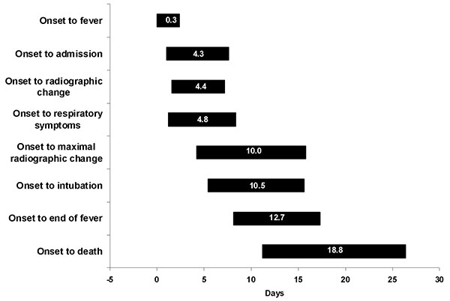
Figure 3
Figure 3.&nbsp;Average (±1 standard deviation) duration of time from onset of illness until outcome in the evolution of severe acute respiratory syndrome, Vietnam, February–May 2003
Vu HT, Leitmeyer KC, Le DH, Miller MJ, Nguyen QH, Uyeki TM, et al. Clinical Description of a Completed Outbreak of SARS in Vietnam, February–May, 2003. Emerg Infect Dis. 2004;10(2):334-338. https://doi.org/10.3201/eid1002.030761

