Slide 1
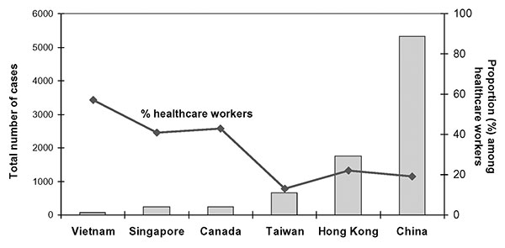
Figure
Figure.&nbsp;Cumulative cases of severe acute respiratory syndrome and proportion among healthcare workers by geographic region, November 1, 2002–July 31, 2003.
Lingappa JR, McDonald LC, Simone P, Parashar UD. Wresting SARS from Uncertainty. Emerg Infect Dis. 2004;10(2):167-170. https://doi.org/10.3201/eid1002.031032

