Slide 1
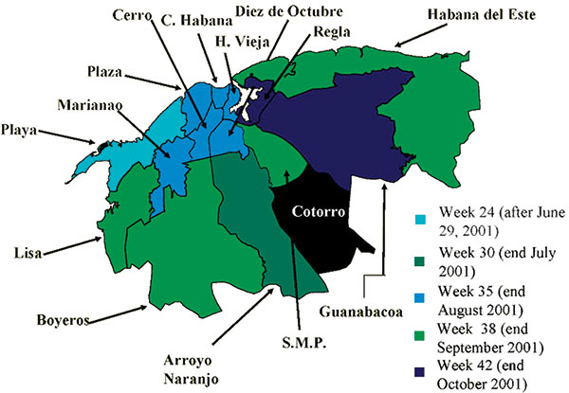
Figure 2
Figure 2.&nbsp;Extension of the epidemic in Havana City, 2001-2002
Peláez O, Guzmán MG, Kourí G, Pérez R, San Martín JL, Vázquez S, et al. Dengue 3 Epidemic, Havana, 2001. Emerg Infect Dis. 2004;10(4):719-722. https://doi.org/10.3201/eid1004.030271

