Slide 1
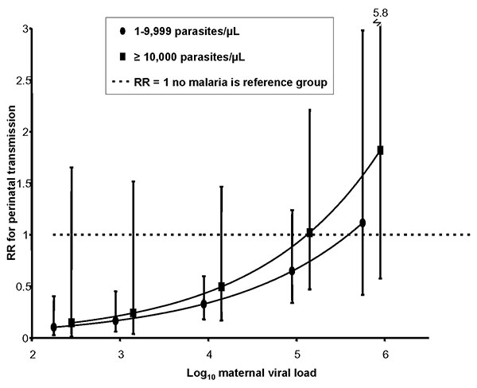
Figure 2
Figure 2.&nbsp;The effect of viral load and high-density placental malaria on risk for perinatal HIV transmission, western Kenya, 1996–2001. Women with high-density placental malaria (&gt;10,000 parasites/μL) are compared to those with low-density placental malaria (&lt;10,000 parasites/μL, represented by the horizontal dashed line). RR, relative risk. Error bars refer to 95% confidence interval.
Ayisi JG, van Eijk AM, Newman RD, ter Kuile FO, Shi Y, Yang C, et al. Maternal Malaria and Perinatal HIV Transmission, Western Kenya. Emerg Infect Dis. 2004;10(4):643-652. https://doi.org/10.3201/eid1004.030303

