Slide 1
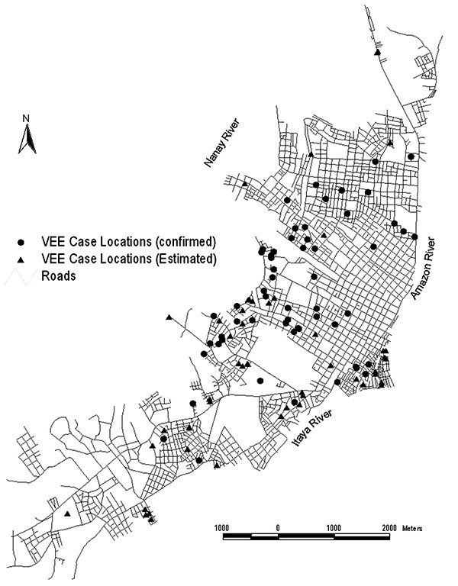
Figure 2
Figure 2.&nbsp;Map of Iquitos showing the locations of human Venezuelan equine encephalitis virus cases in the city.
Aguilar PV, Greene IP, Coffey LL, Medina G, Moncayo AC, Anishchenko M, et al. Endemic Venezuelan Equine Encephalitis in Northern Peru. Emerg Infect Dis. 2004;10(5):880-888. https://doi.org/10.3201/eid1005.030634

