Slide 1
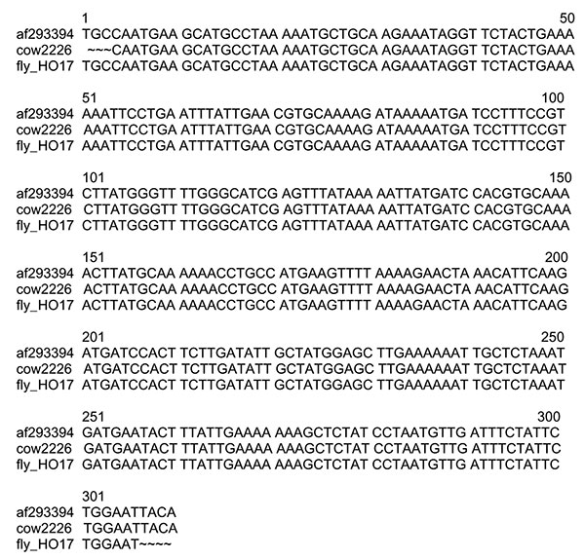
Figure 1
Figure 1.&nbsp;Alignment of BhCS.781p/BhCS.1137n gltA gene amplicons for 306 bp of Bartonella bovis (GenBank accession no. af293394), a B. bovis isolate (cow 2226) from a Californian cow and the horn fly pool (fly-HO17).
Chung CY, Kasten RW, Paff SM, Van Horn BA, Vayssier-Taussat M, Boulouis H, et al. Bartonella spp. DNA Associated with Biting Flies from California. Emerg Infect Dis. 2004;10(7):1311-1313. https://doi.org/10.3201/eid1007.030896

