Slide 1
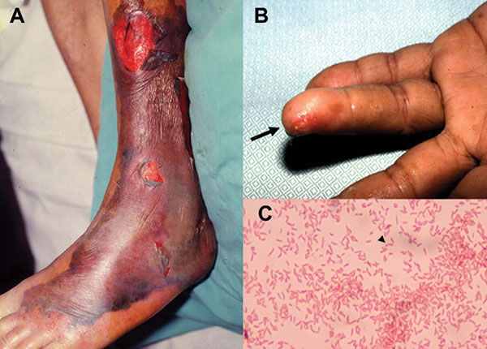
Figure 2
Figure 2.&nbsp;Characteristic skin lesions of Vibrio vulnificus infection and morphotype of the microorganism. (A) Gangrenous change with hemorrhagic bullae over the leg in a 75-year-old patient with liver cirrhosis in whom septic shock and V. vulnificus bacteremia developed. (B) V. vulnificus bacteremia developed 1 day after a fish bone injury over the 4th finger of the left hand (arrow) in a 45-year-old patient with uremia. (C) Gram-negative curved bacilli (arrowhead) isolated from a blood sample of the 45-year-old patient with uremia.
Hsueh P, Lin C, Tang H, Lee H, Liu J, Liu Y, et al. Vibrio vulnificus in Taiwan. Emerg Infect Dis. 2004;10(8):1363-1368. https://doi.org/10.3201/eid1008.040047

