Slide 1
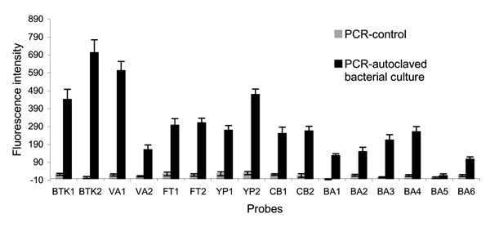
Figure 1
Figure 1.&nbsp;Array detection of single polymerase chain reaction (PCR) products from autoclaved bacterial cultures of the 6 microorganisms listed in Table A3 by using single bead–type arrays. PCR and array hybridization conditions are described in the Appendix. Single bead–type arrays were fabricated containing ≈100 replicates of each microsphere probe. The standard deviation (SD) of background images is 15 (N = 3), and the detection limit is 45, defined as 3 × SD.
Song L, Ahn S, Walt DR. Detecting Biological Warfare Agents. Emerg Infect Dis. 2005;11(10):1629-1632. https://doi.org/10.3201/eid1110.050269

