Slide 1
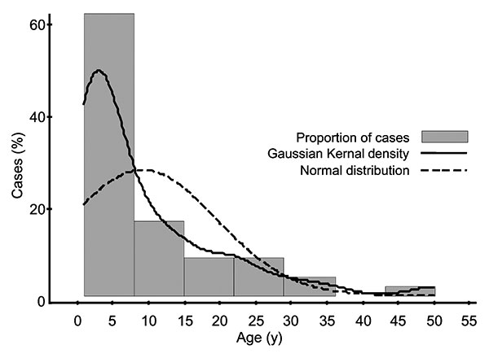
Figure 1
Figure 1.&nbsp;Distribution of typhoid fever by age.
Brooks WA, Hossain A, Goswami D, Sharmeen AT, Nahar K, Alam K, et al. Bacteremic Typhoid Fever in Children in an Urban Slum, Bangladesh. Emerg Infect Dis. 2005;11(2):326-329. https://doi.org/10.3201/eid1102.040422

