Slide 1
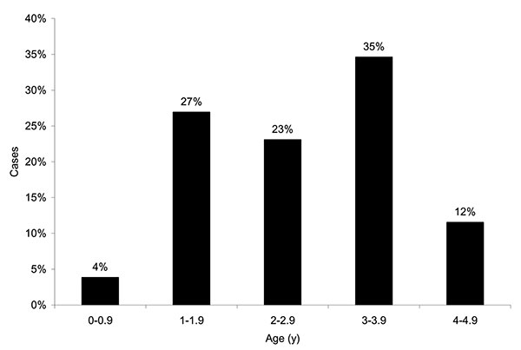
Figure 2
Figure 2.&nbsp;Age distribution of patients &lt;5 years of age with typhoid fever.
Brooks WA, Hossain A, Goswami D, Sharmeen AT, Nahar K, Alam K, et al. Bacteremic Typhoid Fever in Children in an Urban Slum, Bangladesh. Emerg Infect Dis. 2005;11(2):326-329. https://doi.org/10.3201/eid1102.040422

