Slide 1
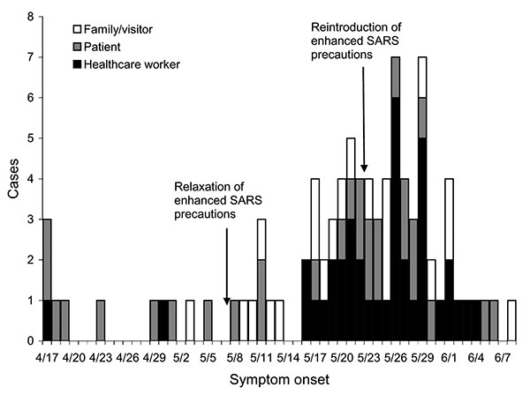
Figure
Figure.&nbsp;Reported probable and suspected severe acute respiratory syndrome cases in persons (or their family members) with symptom onset after April 17, 2003, whose exposure setting was hospital X.
Wong T, Wallington T, McDonald LC, Abbas Z, Christian M, Low DE, et al. Late Recognition of SARS in Nosocomial Outbreak, Toronto. Emerg Infect Dis. 2005;11(2):322-325. https://doi.org/10.3201/eid1102.040607

