Slide 1
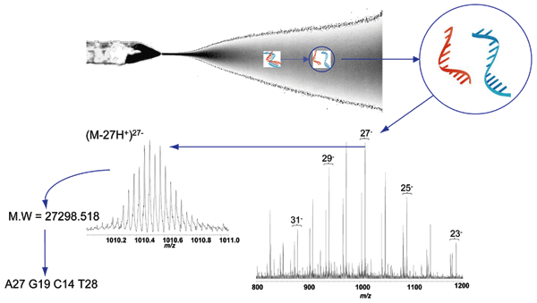
Figure 1
Figure 1. . Electrospray ionization Fourier transfer ion cyclotron resonance (ESI-FTICR) mass spectrum from the polymerase chain reaction (PCR) amplicons from the severe acute respiratory syndrome (SARS)-associated coronavirus obtained with the propynylated RNA-dependent RNA polymerase primer pairs. The electrospray ionization conditions separate the sense and antisense strands of the PCR products. Multiple charge states are observed across the m/z range shown. The inset shows an expanded view of the isotope envelope of the (M-27H+)27- species. As enumerated in Table 1, the derived molecular masses for the amplicon strands are 27298.518 (+ 0.03) Da and 27125.542 (+ 0.03) Da, corresponding to an unambiguous base composition of A27G19C14T28/ A28G14C19T27 for the double-stranded amplicon, the composition expected for the SARS isolate.
Sampath R, Hofstadler SA, Blyn LB, Eshoo MW, Hall TA, Massire C, et al. Rapid Identification of Emerging Pathogens: Coronavirus. Emerg Infect Dis. 2005;11(3):373-379. https://doi.org/10.3201/eid1103.040629

