Slide 1
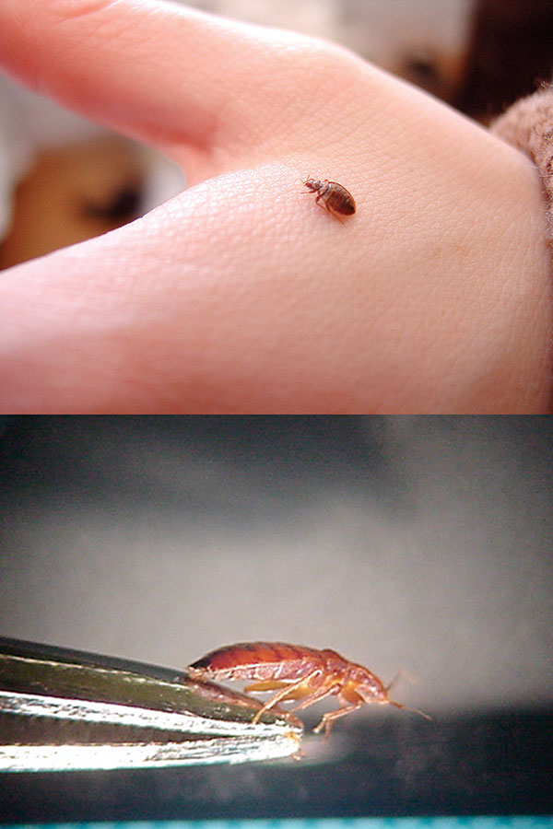
Figure 1
Figure 1.&nbsp;Dorsal and lateral views of a bed bug (Cimex lectularius).
Hwang SW, Svoboda TJ, De Jong IJ, Kabasele KJ, Gogosis E. Bed Bug Infestations in an Urban Environment. Emerg Infect Dis. 2005;11(4):533-538. https://doi.org/10.3201/eid1104.041126

