Slide 1
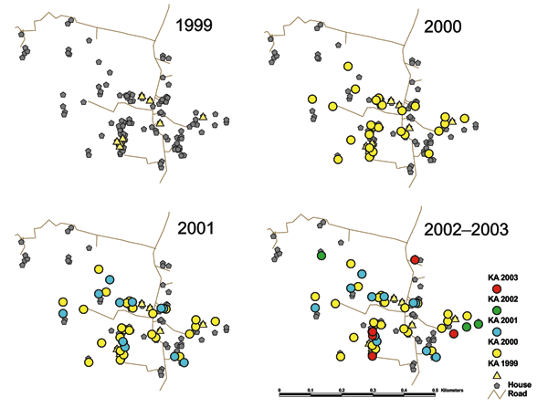
Figure 2
Figure 2. Location of kala-azar patients by year of symptom onset in para 1, Bangladesh, 2000&ndash;2003.
Bern C, Hightower AW, Chowdhury R, Ali M, Amann J, Wagatsuma Y, et al. Risk Factors for Kala-Azar in Bangladesh. Emerg Infect Dis. 2005;11(5):655-662. https://doi.org/10.3201/eid1105.040718

