Slide 1
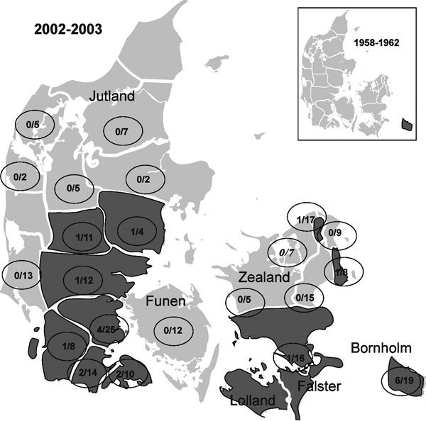
Figure 3
Figure 3. . Distribution of tickborne encephalitis (TBE)-complex virus–positive state forest districts (dark shading) in Denmark, 2002–2003 vs. 1958–1962. Numerators indicate number of TBE-complex virus–positive roe deer; denominators indicate number of deer tested.
Skarphédinsson S, Jensen PM, Kristiansen K. Survey of Tickborne Infections in Denmark. Emerg Infect Dis. 2005;11(7):1055-1061. https://doi.org/10.3201/eid1107.041265

