Slide 1
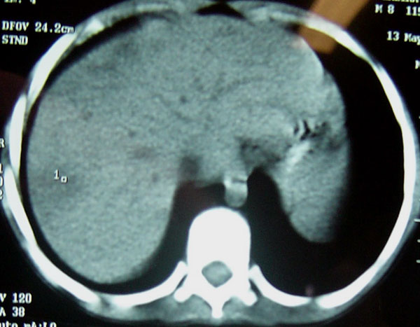
Figure 2
Figure 2. . Computed tomographic scan of abdomen of patient 3, showing multiple, small liver abscesses.
Cristina de Siqueira I, Dias JP, Ruf H, Ramos EG, Maciel E, Rolim A, et al. Chromobacterium violaceum in Siblings, Brazil. Emerg Infect Dis. 2005;11(9):1443-1445. https://doi.org/10.3201/eid1109.050278

