Slide 1
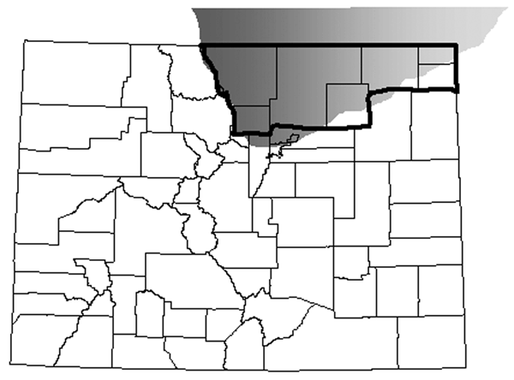
Figure 1
Figure 1.&nbsp;Location of chronic wasting disease (CWD)–endemic area in northeastern Colorado, USA (7) (gray shading) in relationship to Colorado counties regarded as CWD counties (bold outline) for purposes of comparing Creutzfeldt-Jakob disease rates and relative risk among resident human populations.
Pape WJ, Forster JE, Anderson CA, Bosque P, Bosque P, Miller MW. Human Prion Disease and Relative Risk Associated with Chronic Wasting Disease. Emerg Infect Dis. 2006;12(10):1527-1535. https://doi.org/10.3201/eid1210.060019

