Slide 1
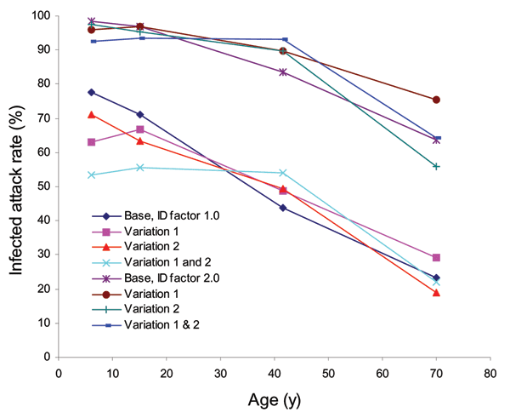
Figure 8
Figure 8.&nbsp;Unmitigated age-specific attack rate results for disease infectivity (ID) factors of 1.0 and 2.0 and base case, variation 1 (removal of relative infectivity and susceptibility), variation 2 (increase in work group frequency of contact to give all children, teenagers, and adults the same overall contact frequencies), and variations 1 and 2 combined. Illness attack rates shown in Figure 6 are half these values.
Glass RJ, Glass LM, Beyeler WE, Min HJ. Targeted Social Distancing Designs for Pandemic Influenza. Emerg Infect Dis. 2006;12(11):1671-1681. https://doi.org/10.3201/eid1211.060255

