Slide 1
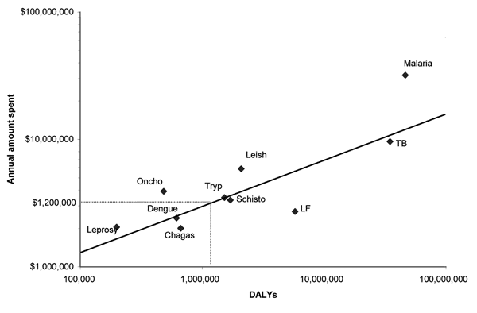
Figure 2
Figure 2.&nbsp;Annual budget (in US $) for diseases included in the United Nations Children's Fund/UNDP/World Bank/World Health Organization–supported Special Programme for Research and Training in Tropical Diseases (TDR) compared to their estimated global disability-associated life years (DALYs). The thinner lines indicate estimated DALYs lost because of cystic echinococcosis (CE) and the recommended funding level based on the TDR 2004–2005 approved program budget (Oncho, onchocerciasis; Tryp, trypanosomiasis; Schisto, schistosomiasis; Leish, leishmaniasis; LF, lymphatic filariasis; TB, tuberculosis). This figure does not take into account the substantial regional variability in both the estimates of DALYs lost and the annual budget for the diseases illustrated.
Budke CM, Deplazes P, Torgerson PR. Global Socioeconomic Impact of Cystic Echinococcosis. Emerg Infect Dis. 2006;12(2):296-303. https://doi.org/10.3201/eid1202.050499

