Slide 1
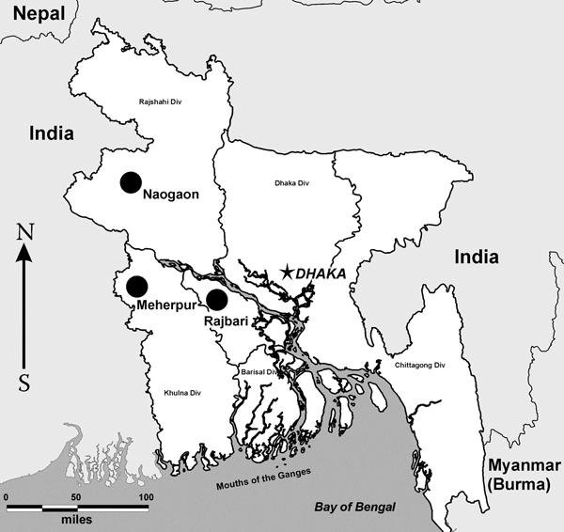
Figure 1
Figure 1.&nbsp;Map of Bangladesh with bat surveillance regions indicated (circles).
Kuzmin IV, Niezgoda M, Carroll DS, Keeler N, Hossain M, Breiman RF, et al. Lyssavirus Surveillance in Bats, Bangladesh. Emerg Infect Dis. 2006;12(3):486-488. https://doi.org/10.3201/eid1203.050333

