Slide 1
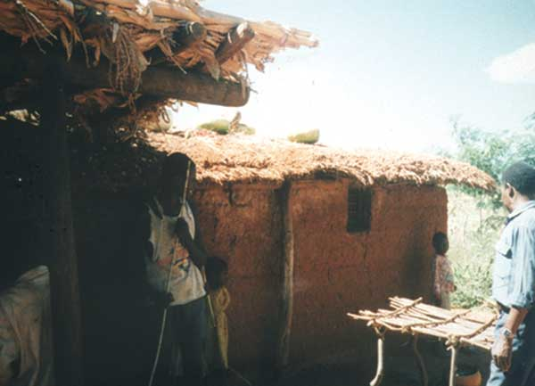
Figure 2
Figure 2.&nbsp;Traditional Tembe dwelling in Tanzania.
Cutler SJ. Possibilities for Relapsing Fever Reemergence. Emerg Infect Dis. 2006;12(3):369-374. https://doi.org/10.3201/eid1203.050899

