Slide 1
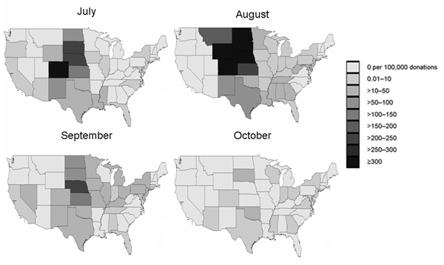
Figure 2
Figure 2.&nbsp;Yield of minipool–nucleic acid testing of blood donors for West Nile virus RNA by state and month, 2003.
Murphy EL, Wright DJ, Custer BS, Tobler LH, Stramer SL, Kleinman SH, et al. West Nile Virus Infections Projected from Blood Donor Screening Data, United States, 2003. Emerg Infect Dis. 2006;12(3):395-402. https://doi.org/10.3201/eid1203.051287

