Slide 1
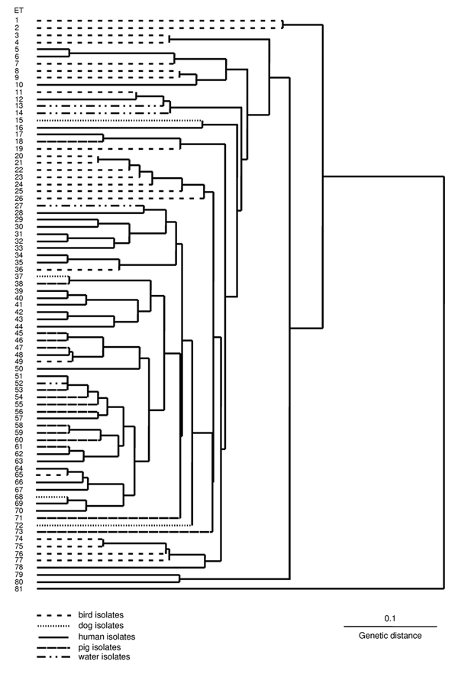
Figure
Figure.&nbsp;Dendrogram showing relationships between 107 isolates of Brachyspira pilosicoli originating from various host species located in electrophoretic types (ETs) 1-80 and B. aalborgi NCTC 11492T located in ET81.
Hampson DJ, Oxberry SL, La T. Potential for Zoonotic Transmission of Brachyspira pilosicoli. Emerg Infect Dis. 2006;12(5):869-870. https://doi.org/10.3201/eid1205.051180

