Slide 1
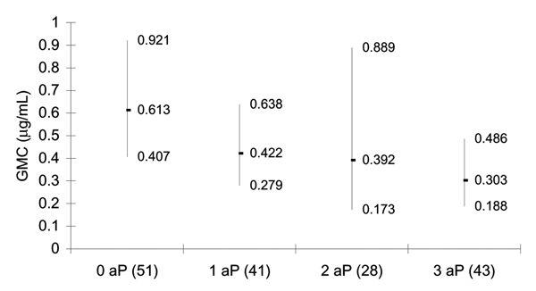
Figure 1
Figure 1.&nbsp;Geometric mean anti-polyribosyl-ribitol phosphate antibody concentration before booster (95% confidence intervals) in 2- to 4-year-old children, according to number of doses of acellular pertussis (aP) containing Haemophilus influenzae type b combination vaccines received in infancy. Number of participants is shown in parentheses. GMC, geometric mean concentration.
Johnson NG, Ruggeberg JU, Balfour GF, Lee Y, Liddy H, Irving D, et al. Haemophilus influenzae Type b Reemergence after Combination Immunization. Emerg Infect Dis. 2006;12(6):937-941. https://doi.org/10.3201/eid1206.051451

