Slide 1
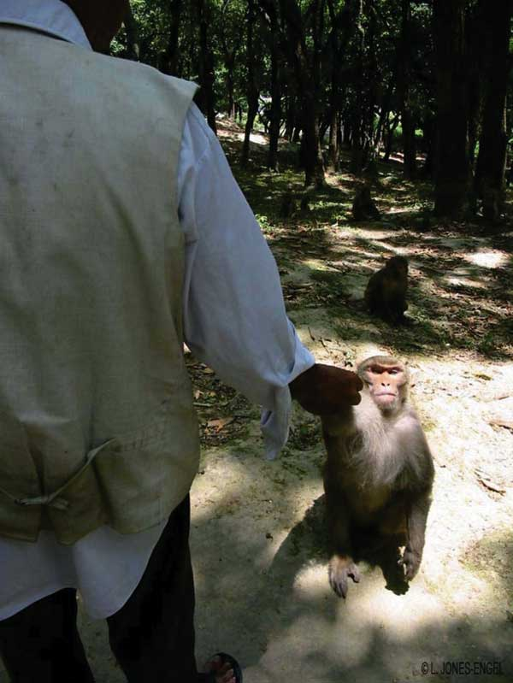
Figure 2
Figure 2.&nbsp;Rhesus macaques at Swoyambhu Temple routinely get food handouts from local inhabitants and visitors. (Photo by L. Jones-Engel.)
Jones-Engel L, Engel G, Heidrich J, Chalise M, Poudel N, Viscidi R, et al. Temple Monkeys and Health Implications of Commensalism, Kathmandu, Nepal. Emerg Infect Dis. 2006;12(6):900-906. https://doi.org/10.3201/eid1206.060030

