Slide 1
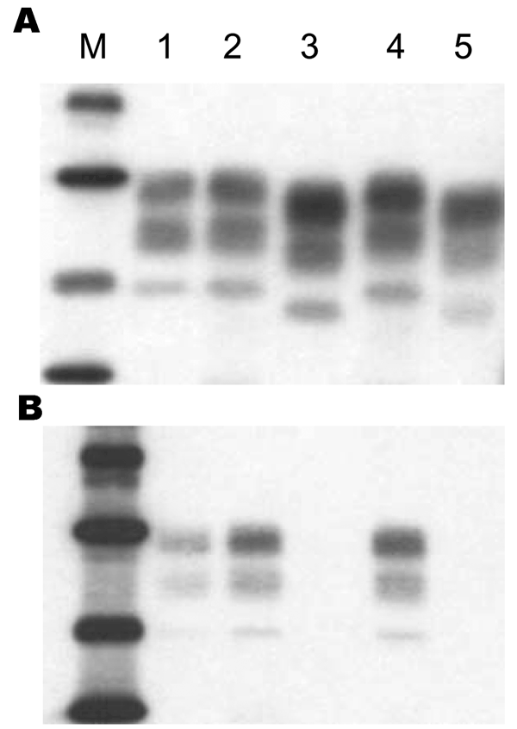
Figure 1
Figure 1.&nbsp;Western blot analysis of disease-associated prion protein (PrPres) from proteinase K–treated brain homogenates of C57BL/6 mice infected with type H (lanes 2 and 4) or bovine spongiform encephalopathy isolates (lanes 3 and 5). PrPres of mice infected with an experimental scrapie strain (C506M3) (6) was used as a control (lane 1). Monoclonal antibodies used for detection of PrPres were Sha31 in panel A and 12B2 in panel B. Lane M, molecular mass markers: 39.8, 29, 20.1, and 14.3 kDa.
Baron T, Biacabe A, Bencsik A, Langeveld J. Transmission of New Bovine Prion to Mice. Emerg Infect Dis. 2006;12(7):1125-1128. https://doi.org/10.3201/eid1207.060107

