Slide 1
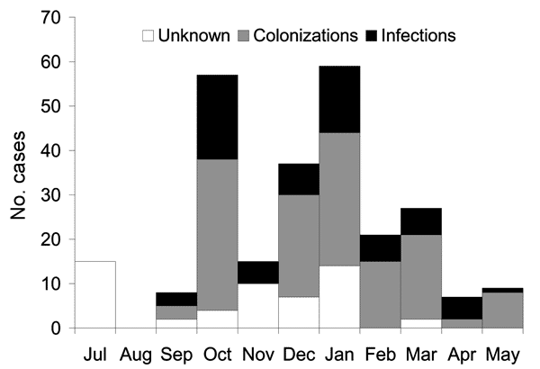
Figure 1
Figure 1.&nbsp;Number of VEB-1–producing Acinetobacter baumannii cases, by month of report, France, July 2003–May 2004 (N = 255).
Naas T, Coignard B, Carbonne A, Blanckaert K, Bajolet O, Bernet C, et al. VEB-1 Extended-Spectrum β-lactamase–producing Acinetobacter baumannii, France. Emerg Infect Dis. 2006;12(8):1214-1222. https://doi.org/10.3201/eid1208.051547

