Slide 1
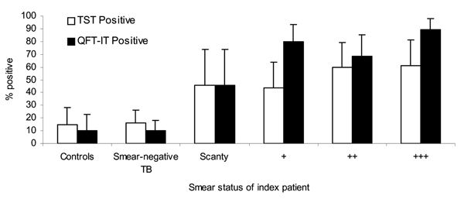
Figure 2
Figure 2.&nbsp;Proportion of children with positive tuberculin skin test (TST) (&gt;10 mm) and QuantiFERON Gold in Tube (QFT-IT) test results, by adult smear positivity. Error bars show 95% confidence intervals.
Nakaoka H, Lawson L, Squire SB, Coulter B, Ravn P, Brock I, et al. Risk for Tuberculosis among Children. Emerg Infect Dis. 2006;12(9):1383-1388. https://doi.org/10.3201/eid1209.051606

