Slide 1
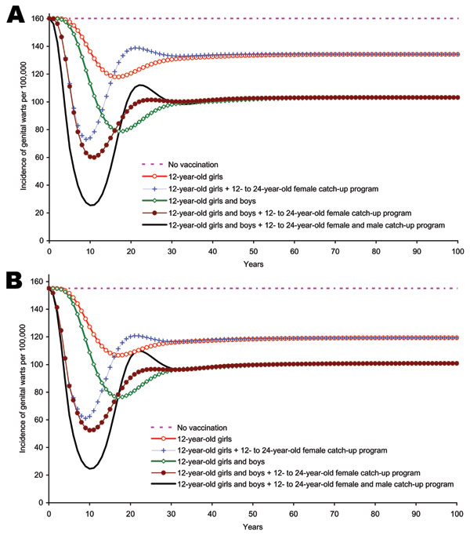
Figure 6
Figure 6.&nbsp;Sensitivity analysis. A) Incidence of genital warts due to human papillomavirus (HPV) 6/11 infection among boys and men &gt;12 years of age, by strategy, 10 years’ duration of protection. B) Incidence of genital warts due to (HPV 6/11 infection among girls and women &gt;12 years of age by strategy, 10 years’ duration of protection.
Elbasha EH, Dasbach EJ, Insinga RP. Model for Assessing Human Papillomavirus Vaccination Strategies. Emerg Infect Dis. 2007;13(1):28. https://doi.org/10.3201/eid1301.060438

