Slide 1
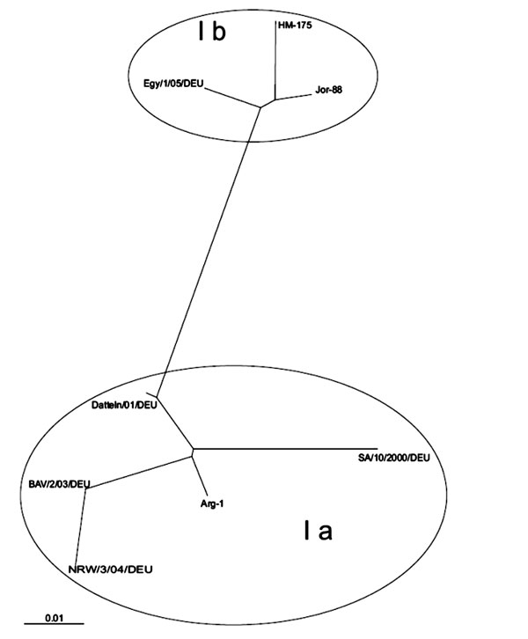
Figure 3
Figure 3.&nbsp;Phylogenetic analysis of the VP1–2A junction region. The sequence of a 160-bp-long PCR fragment (isolate Egy/1/05/DEU, GenBank accession no. AY741663) of the hepatitis A VP1 region was compared to published reference sequences of hepatis A virus. Genotype Ia: GenBank accession nos. AJ306374(Arg-1), AY656712 (BAV/2/03/DEU*), AY028976 (SA/10/2000/DEU), AY046073 (Datteln/01/DEU), and AY747173 (NRW/3/04/DEU*). Genotype Ib: L07728 (Jor 88), M14707 (HM-175). The scale represents nucleotide substitutions per position (* denotes previous German outbreak-causing strains).
Frank C, Walter J, Muehlen M, Jansen A, van Treeck U, Hauri AM, et al. Major Outbreak of Hepatitis A Associated with Orange Juice among Tourists, Egypt, 2004. Emerg Infect Dis. 2007;13(1):156. https://doi.org/10.3201/eid1301.060487

