Slide 1
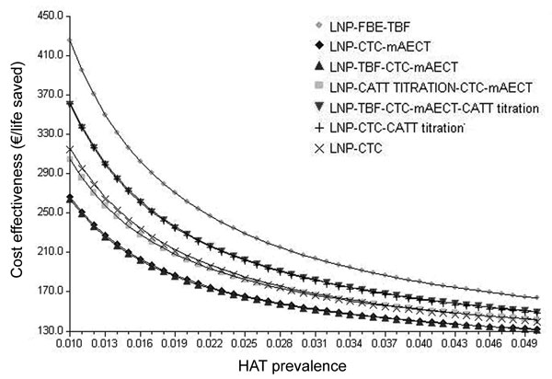
Figure 3
Figure 3.&nbsp;Variations in cost-effectiveness ratios as a function of prevalence of human African trypanosomiasis (HAT). LNP, lymph node puncture; FBE, fresh blood examination; TBF, thick blood film; CTC, capillary tube centrifugation; mAECT, mini-anion-exchange centrifugation technique; CATT, card agglutination test for trypanosomiasis; CATT titration, CATT titration at end-titer 8.
Lutumba P, Meheus F, Robays J, Miaka C, Kande V, Büscher P, et al. Cost-effectiveness of Algorithms for Confirmation Test of Human African Trypanosomiasis. Emerg Infect Dis. 2007;13(10):1484. https://doi.org/10.3201/eid1310.060358

