Slide 1
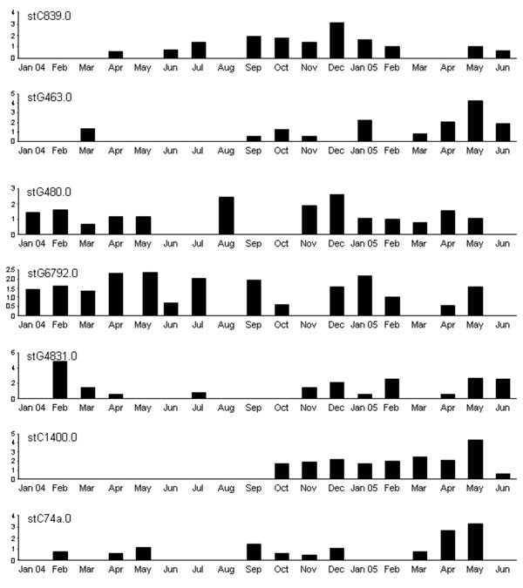
Figure 1
Figure 1.&nbsp;Monthly recovery rates of most common Streptococcus dysgalactiae subsp. equisimilis (group C and group G streptococci) emm sequence subtypes (STs) in community 1, Northern Territory, Australia. Values along the y-axes are no. bacterial isolates per 100 consultations. No obvious pattern of sequential strain replacement was seen as with Streptococcus pyogenes (group A streptococci) (17).
McDonald M, Towers RJ, Andrews RM, Carapetis JR, Currie BJ. Epidemiology of Streptococcus dysgalactiae subsp. equisimilis in Tropical Communities, Northern Australia. Emerg Infect Dis. 2007;13(11):1694-1700. https://doi.org/10.3201/eid1311.061258

