Slide 1
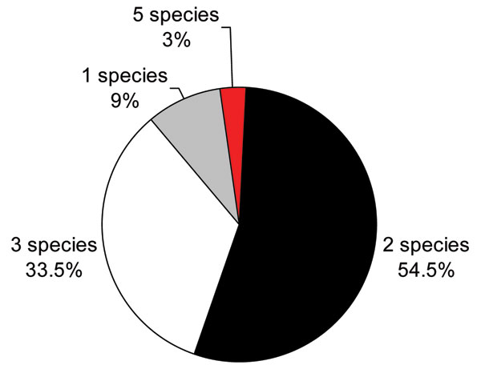
Figure 4
Figure 4.&nbsp;Multiple fishborne trematode infections in humans, Nam Dinh Province, Vietnam, April 2005.
Dung DT, Van De N, Waikagul J, Dalsgaard A, Chai J, Sohn W, et al. Fishborne Zoonotic Intestinal Trematodes, Vietnam. Emerg Infect Dis. 2007;13(12):1828-1833. https://doi.org/10.3201/eid1312.070554

