Slide 1
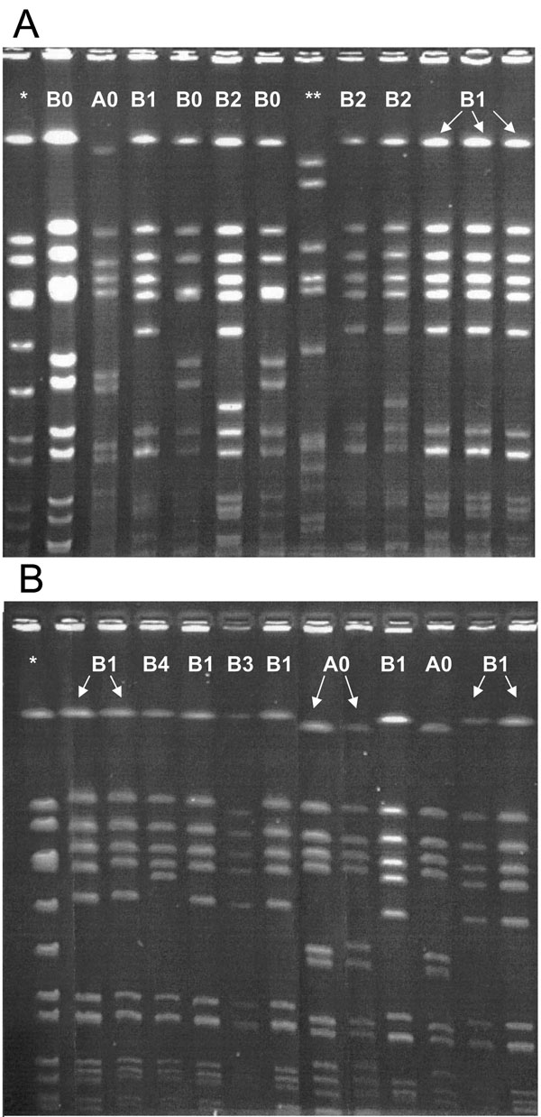
Figure
Figure.&nbsp;Pulsed-field gel electrophoresis (PFGE) results for community-associated methicillin-resistant Staphylococcus aureus (MRSA) isolates causing disease. A) Local skin and soft tissue isolates. B) Invasive isolates. *, PFGE control; **, clinical isolate, hospital-associated MRSA.
Jaggi P, Paule SM, Peterson LR, Tan TQ. Characteristics of Staphylococcus aureus Infections, Chicago Pediatric Hospital. Emerg Infect Dis. 2007;13(2):311. https://doi.org/10.3201/eid1302.060295

