Slide 1
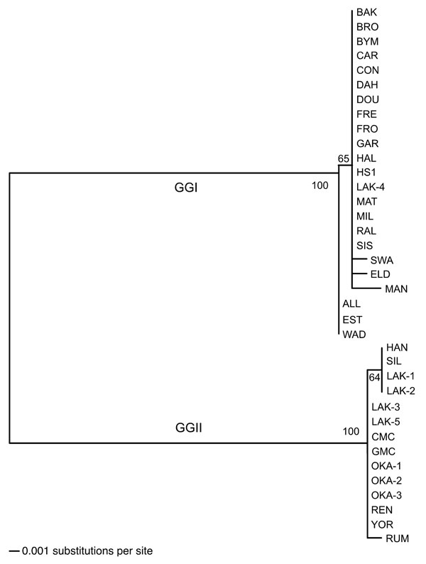
Figure 2
Figure 2.&nbsp;Phylogram of the intergenic spacer sequences of 37 Borrelia hermsii isolates. The tree was constructed with ClustalV and the neighbor-joining method with 1,000 bootstrap replicates. Numbers at the nodes are the percentages of bootstraps that supported this pattern. The scale bar for the branch lengths represents the number of substitutions per site. An unrooted tree is shown because a gap in the alignment with B. turicatae resulted in the removal of a polymorphic site in some GGII isolates of B. hermsii.
Schwan TG, Raffel SJ, Schrumpf ME, Porcella SF. Diversity and Distribution of Borrelia hermsii. Emerg Infect Dis. 2007;13(3):436. https://doi.org/10.3201/eid1303.060958

