Slide 1
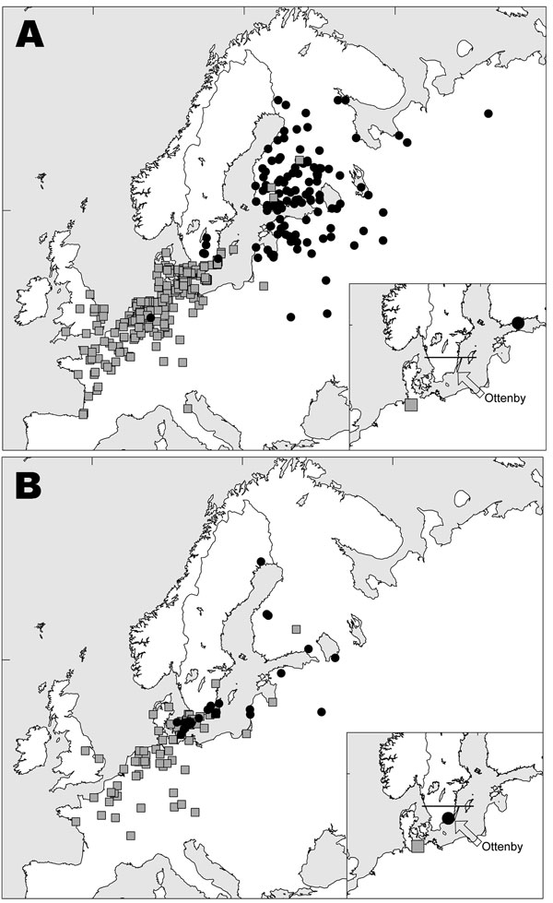
Figure 1
Figure 1.&nbsp;Female mallards banded in Sweden south of 57°30′N (indicated by a solid line in the inserted figures) in Oct–Dec (A) and May–Sep (B) and recovered in winter (Nov–Feb, n = 255 and n = 98) and summer (May–Aug, n = 135 and n = 53). Black dots represent summer recoveries; gray squares represent winter recoveries. Symbols on inset maps represent calculated mean positions and the location of Ottenby Bird Observatory.
Wallensten A, Munster VJ, Latorre-Margalef N, Brytting M, Elmberg J, Fouchier R, et al. Surveillance of Influenza Virus A in Migratory Waterfowl in Northern Europe. Emerg Infect Dis. 2007;13(3):404. https://doi.org/10.3201/eid1303.061130

