Slide 1
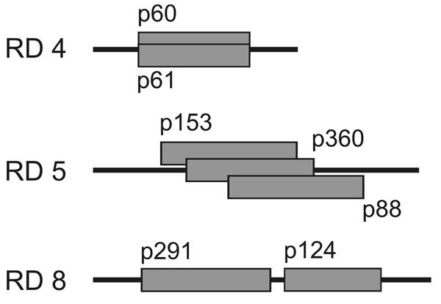
Figure 4
Figure 4.&nbsp;Positions of overlapping or adjacent plasmid inserts in regions of difference (RDs) 4, 5, and 8. Identical results retrieved by different plasmids with overlapping sequences or sequences in closest proximity demonstrate the reproducibility and reliability of the differential genomic hybridization method.
Rondini S, Käser M, Stinear TP, Tessier M, Mangold C, Dernick G, et al. Ongoing Genome Reduction in Mycobacterium ulcerans. Emerg Infect Dis. 2007;13(7):1008. https://doi.org/10.3201/eid1307.060205

