Slide 1
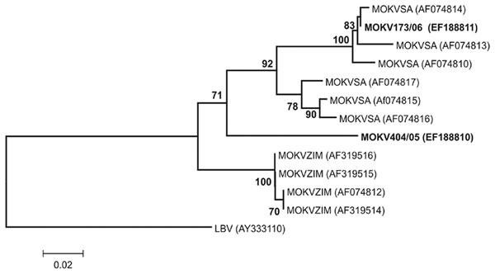
Figure
Figure.&nbsp;Phylogenetic tree based on 267 nt of partial nucleoprotein gene sequences of Moloka virus (MOKV) identified with the N1-N2 primer set as described (12). The tree shows phylogenetic positions of 2 recently identified cases of MOKV infection from South Africa (MOKV173/06 from a cat and MOKV404/05 from a dog) (in boldface) relative to previously characterized MOKV isolates from South Africa (SA) and Zimbabwe (ZIM) and Lagos bat virus (LBV) as the outgroup. GenBank accession nos. are shown in parenthesis. Bootstrap support values &gt;70% are considered significant and indicated. Scale bar shows nucleotide substitutions per site.
Sabeta CT, Markotter W, Mohale DK, Shumba W, Wandeler AI, Nel LH. Mokola Virus in Domestic Mammals, South Africa. Emerg Infect Dis. 2007;13(9):1371. https://doi.org/10.3201/eid1309.070466

