Slide 1
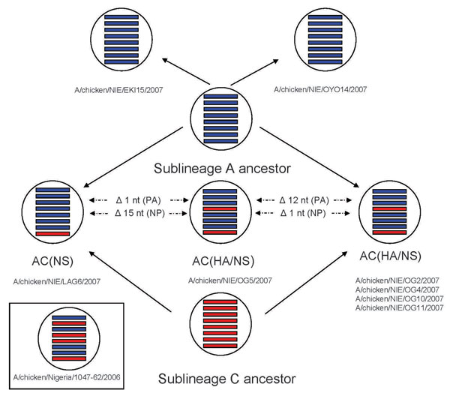
Figure 2
Figure 2.&nbsp;Schematic presentation of sublineage A–derived highly pathogenic avian influenza viruses (H5N1) and reassortants of sublineage A– and sublineage C–derived viruses identified in Nigeria in 2007. The reassortant reported from Salzberg and others in 2007 (3) is also shown. Sublineage A–derived gene segments are shown in blue; sublineage C–derived gene segments are shown in red. Gene segments are represented in the following order (from top): PB2, PB1, PA, HA, NP, NA, M, NS.
Owoade AA, Gerloff NA, Ducatez MF, Taiwo JO, Kremer JR, Muller CP. Replacement of Sublineages of Avian Influenza (H5N1) by Reassortments, Sub-Saharan Africa. Emerg Infect Dis. 2008;14(11):1731-1735. https://doi.org/10.3201/eid1411.080555

