Slide 1
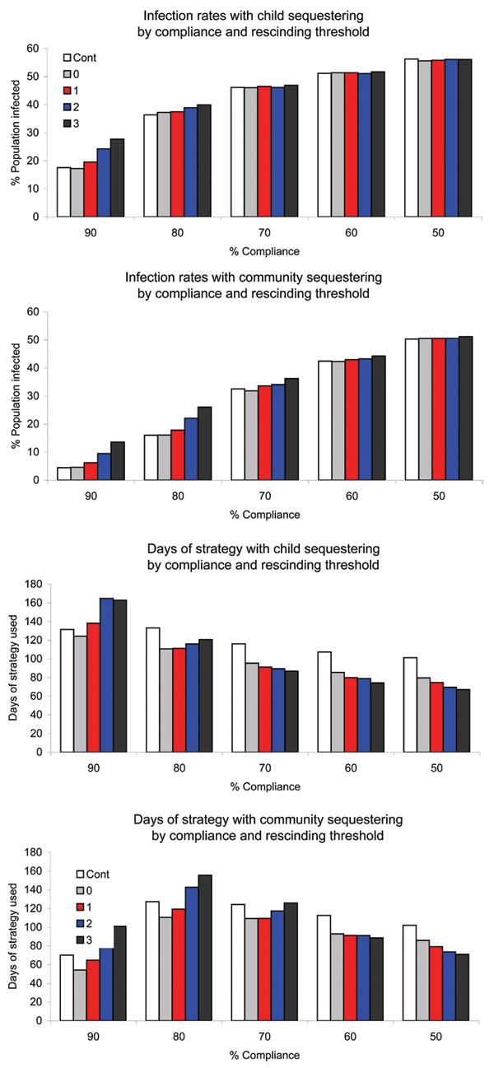
Figure 4
Figure 4.&nbsp;Infection rates and duration of strategy in severe epidemics by level of compliance for child sequestering and community sequestering, and rescinding threshold (Cont, 0, 1, 2, or 3). Cont, strategy continuation for the duration of the epidemic.
Davey VJ, Glass RJ. Rescinding Community Mitigation Strategies in an Influenza Pandemic. Emerg Infect Dis. 2008;14(3):365-372. https://doi.org/10.3201/eid1403.070673

