Slide 1
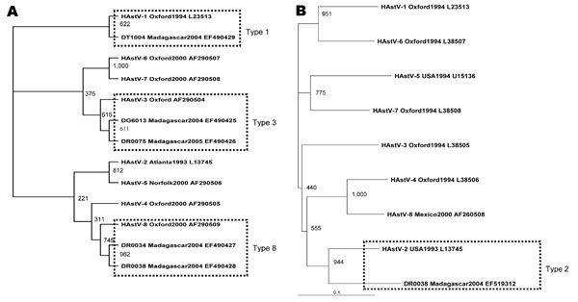
Figure
Figure.&nbsp;Phylogenetic tree of human astrovirus (HAstV) based on the 289-base region of the open reading frame (ORF) 1a gene (A) and the 413-base region of the ORF2 gene (B). We included 6 novel sequences designated according to isolate code_place/year_GenBank accession no. A) DG6013_Madagascar2004_EF490425, DR0075_Madagascar2005_EF490426, DR0034_Madagascar2004_EF490427, DR0038_Madagascar2004_EF490428, DT1004_Madagascar2004_EF490429; B) DR0038_Madagascar2004_EF519312. We also included 16 sequences of reference astrovirus strains obtained from GenBank, designated according to HAstV genotype_place/year_GenBank accession no.: A) HAstV-1_Oxford1994_L23513, HAstV-2_Atlanta1993_L13745, HAstV-3_Oxford_AF290504, HAstV-4_Oxford2000_AF290505, HAstV-5_Norfolk2000_AF290506, HAstV-6_Oxford2000_AF290507, HAstV-7_Oxford2000_AF290508, HAstV-8_Oxford2000_AF290509; B) HAstV-1_Oxford1994_L23513, HAstV-2_USA1993_ L13745, HAstV-3_Oxford1994_L38505, HAstV-4_Oxford1994_L38506, HAstV-5_USA1994_U15136, HAstV-6_Oxford1994_L38507, HAstV-7_Oxford1994_L38508, HAstV-8_Mexico2000_AF260508. Bootstrap values based on 1,000 generated trees are displayed at the nodes.
Papaventsis DC, Dove W, Cunliffe NA, Nakagomi O, Combe P, Grosjean P, et al. Human Astrovirus Gastroenteritis in Children, Madagascar, 2004–2005. Emerg Infect Dis. 2008;14(5):844-846. https://doi.org/10.3201/eid1405.070563

