Slide 1
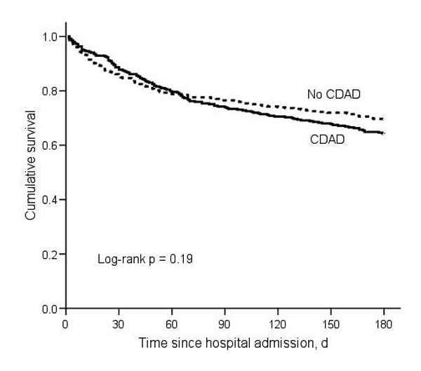
Figure 3
Figure 3.&nbsp;Kaplan-Meier survival estimates for matched pairs (n = 706). CDAD, Clostridium difficile–associated disease.
Dubberke ER, Butler AM, Reske KA, Agniel D, Olsen MA, D’Angelo G, et al. Attributable Outcomes of Endemic Clostridium difficile–associated Disease in Nonsurgical Patients. Emerg Infect Dis. 2008;14(7):1031-1038. https://doi.org/10.3201/eid1407.070867

