Slide 1
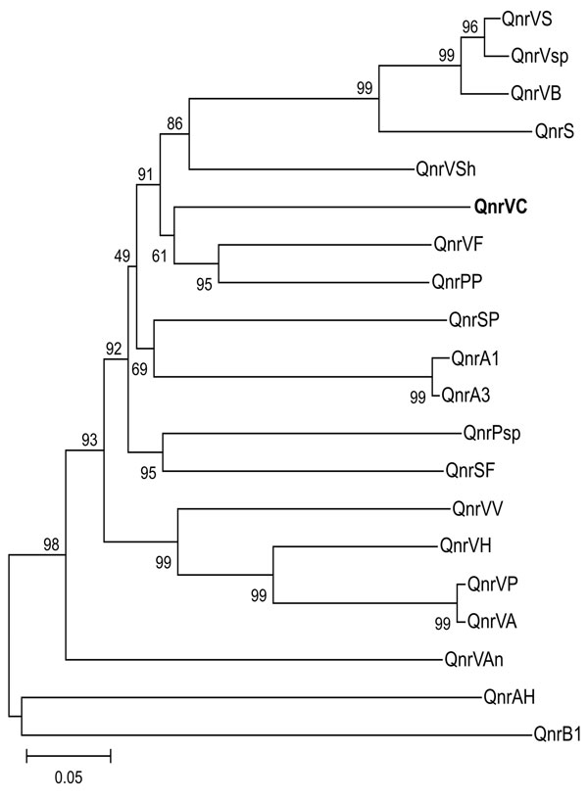
Figure
Figure.&nbsp;Genetic relationships of plasmid- and chromosome-encoded qnr proteins. Species and GenBank accession nos. are as follows. QnrVS (Vibrio splendidus, EAP95542), QnrVsp (Vibrio sp., EAQ55748), QnrS1 (Shigella flexneri, BAD88776), QnrVC (V. cholerae, strain 627; EU436855; this work, shown in boldface); QnrPP (Photobacterium profundum, YP132629), QnrVF (V. fisheri, AAW85819), QnrSP (Shewanella pealeana, EAV99957), QnrA1 (Escherichia coli, AAY46800), QnrA3 (S. algae, AAZ04782), QnrPsp (Psychromonas sp., EAS39797), QnrSF (S. frigidimarina, ABI71948), QnrVV (V. vulnificus, AAO07889), QnrVP (V. parahaemolyticus, BAC61438), QnrVA (V. alginolyticus, EAS75285), QnrVAn (V. angustum, EAS64891), QnrAH (Aeromonas hydrophila, ABK38882), QnrB1 (Klebsiella pneumoniae, ABG82188), QnrVSh (V. shilonii, EDL55273), QnrVB (Vibrionales bacterium, EDK31146), QnrVH (V. harveyi, EDL69958). Support of the branching order was determined by 1,000 interior branch test replicates. The distance-based tree was generated by using p distance with the neighbor-joining method with MEGA version 3.1 (www.megasoftware.net). Values along the horizontal lines are the interior-branch test percentages after testing 1,000 topologies. Scale bar indicates the number of substitutions per alignment site, which is reflected by branch lengths.
Fonseca ÉL, Freitas Fd, Vieira VV, Vicente AC. New qnr Gene Cassettes Associated with Superintegron Repeats in Vibrio cholerae O1. Emerg Infect Dis. 2008;14(7):1129-1131. https://doi.org/10.3201/eid1407.080132

