Slide 1
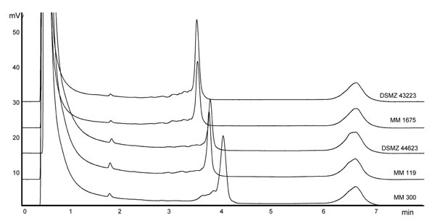
Figure
Figure.&nbsp;Denaturating high-performance liquid chromatography profiles after separation of PCR-amplified internal transcribed spacer regions of Mycobacterium spp. Strain designations from above: DSMZ 43223, M. intracellulare, sequevar MIN-A type strain; MM 1675, M. intracellulare, sequevar MIN-A, patient strain; DSMZ 44623, M. chimaera sp. nov., sequevar MAC-A type strain; MM 119; M. chimaera sp. nov., sequevar MAC-A, patient strain; MM 300, M. intracellulare, sequevar MIN-C, patient strain.
Schweickert B, Goldenberg O, Richter E, Göbel UB, Petrich A, Buchholz P, et al. Occurrence and Clinical Relevance of Mycobacterium chimaera sp. nov., Germany. Emerg Infect Dis. 2008;14(9):1443-1446. https://doi.org/10.3201/eid1409.071032

